Slide 1






Voting application using Django framework
Student Details
Name: Subhanu.C
NM Id: au922221104045
College Name: Theni Kammavar Sangam Collage of Technology

Slide 2

Course Outline
Abstract
Problem Statement
Aims, Objective
Proposed Solution
System architecture
Technology used
application
Conclusion

Slide 3
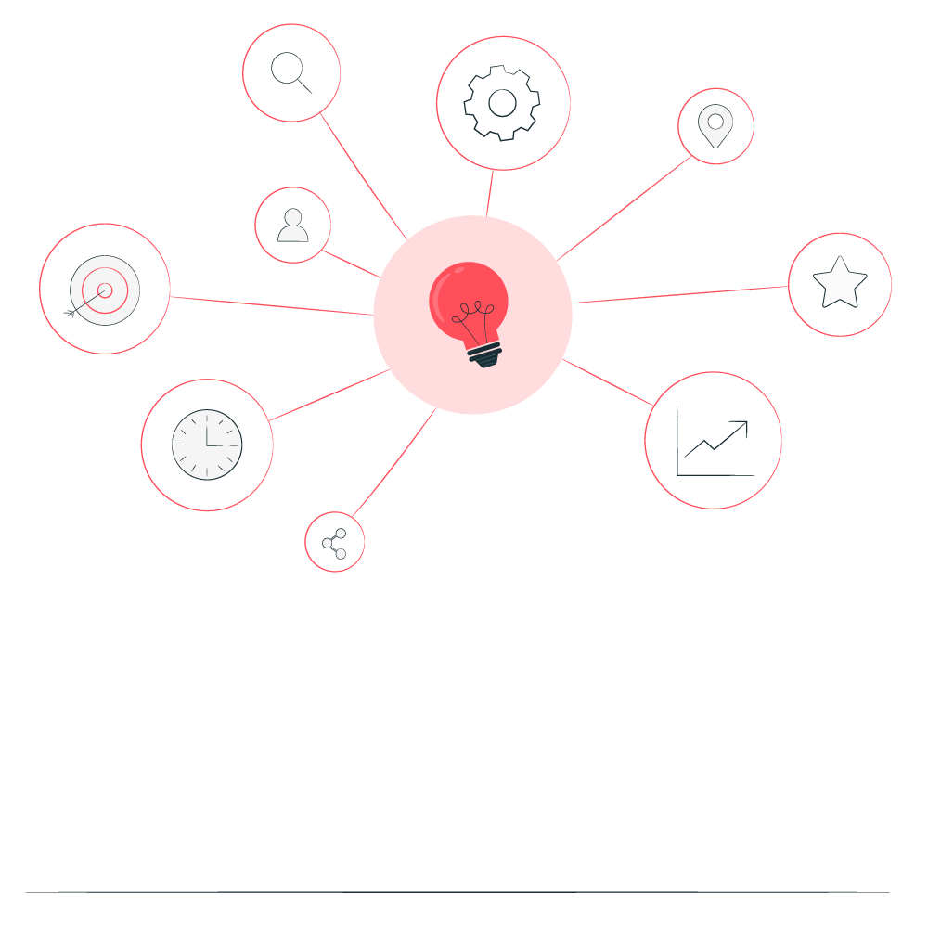

Abstract
1.We are developing a voting application system by taking advantage of the centralized database with a web interface
2.The main concept of this project is to build a website , which should be able to allow people to cast their vote by online
3.Time saving , working load reduced , information available at time and it provide security for the clean
primary goal of our project is,
To develop a user-friendly and secure voting web application using Django framework . the application will serve s a centralized platforms for organization , communities and individuals to create, manage and participate in online polls

Slide 4


Problem Statement
As information technology evolves over time ,the need for a better ,faster , more conventional and secure online voting is essential requirements
The security is one of the main concerns , such as authentication ,confidentiality , integrity and non-repetition .it is not an easy task to achieve secure voting

Slide 5

Aim and Objective
Aim: The primary objective of this Final Seminar is to present the outcomes and advancements made in the project “voting application using Django framework “

Slide 6
Objectives
User Authentication: Implement user authentication to allow users to sign up, log in, and log out securely. Django provides built-in authentication tools to help with this.
Real-time Processing Optimization: Implement real-time updates using technologies like WebSockets or AJAX to show live vote counts without refreshing the page.
Security: Implement security measures to prevent unauthorized access and protect user data. This includes proper authentication, authorization, and validation of user input.
User Interface Integration: Develop a user-friendly interface for the application, including voting forms, result displays, and navigation menus. Consider usability and accessibility principles to ensure a positive user experience.
Scalability :Design the application to handle a large number of users and votes efficiently. Consider techniques such as caching, database optimization, and horizontal scaling to improve performance.

Slide 7

Proposed Solution
Solution:
if secure and convenient voting system is provided it will be used more frequently to collect peoples opinion for much kind of political and social decisions through cyber space.
This system has been developed to simplifying the process of organizing elections and make it convenient for voters to vote remotely from their home computers while taking into consideration security ,anonymity an providing auditioning capabilities
Notes:
‹#›

Slide 8
System architecture
input
Registration process
candidate
Registered voter
database
Registered candidate
voting
Update &
Add voter details
Add candidate
admin
Update candidate details
Notes:
‹#›

Slide 9
Technology used
Software requirements
Front-end:
HTML
CSS
JavaScript
python
Back-end
My sql

Slide 10
application
1.The web application for today mobile and digital advanced society to participate in the democratic process over the internet
2.The online voting system offers the highest levels of transparency , control security and efficiency of election processes

Slide 11
In conclusion ,
the development of a voting web application using the Django framework is crucial step towards addressing the need for an efficient and accessible platform for conducting online polls this project aims to provide a user friendly space for organization and individual to create ,manage , participate in polls.
Promoting transparency and trust in the democratic process with a focus on simplicity security and real time result reporting the application aims to empower users to make informed decisions and enhance civic engagement.

Slide 12
Thank you!
Notes:
‹#›

